Slide 1

Analysis of Health Factors in stroke vs. non-stroke patients
Christiana Kim

Slide 2
Objective of Analysis
Determine underlying health factors that may impact risk for stroke
Better understand patient health and optimize healthcare

Slide 3
Data Overview
Sample of 4909 patients
209 stroke patients, 4700 non-stroke
Data source: ’Stroke Prediction Dataset’ from Kaggle
https://www.kaggle.com/fedesoriano/stroke-prediction-dataset

Slide 4
Hypothesis & Method
There is a significant difference in average glucose level and body mass index (BMI) between stroke patients and non-stroke patients.
Via t-test:
H₀: µ₁ - µ₂ = 0
Hₐ: µ₁ - µ₂ ≠ 0

Slide 5

Average Glucose Level

Slide 6
Descriptive Statistics
Min: 55.12
Max: 271.74
Mean: 105.31
Median: 91.68

Slide 7
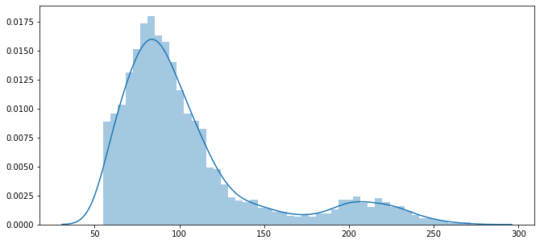
Average Glucose Level

Slide 8
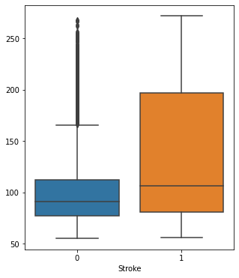
Average Glucose Level
Positive skews
Non-stroke patients have many outliers
Stroke patients have a larger interquartile range (dispersion)

Slide 9
Glucose T-test
H₀: µ₁ - µ₂ = 0
Hₐ: µ₁ - µ₂ ≠ 0
T-statistic = -9.83
P-value = 1.379e-22
Reject null hypothesis, difference is significant at the < 0.005 level
With 95% confidence, the difference is between 2.011 and 39.125

Slide 10

Body Mass Index (BMI)

Slide 11
Descriptive Statistics
Min: 10.3
Max: 97.6
Mean: 28.9
Median: 97.6

Slide 12
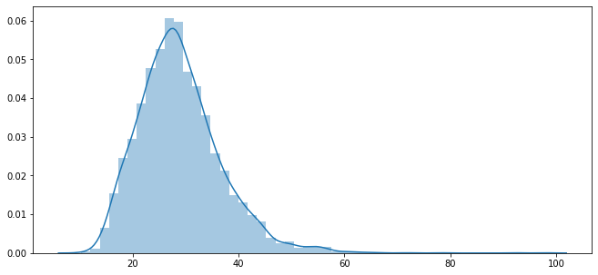
Body Mass Index

Slide 13
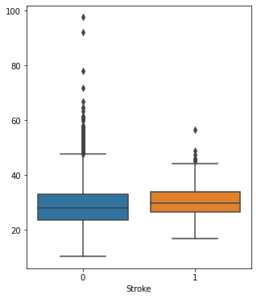
Body Mass Index
Positive skews
Non-stroke patients have larger dispersion and more outliers
Stroke patients have a higher median

Slide 14
BMI T-test
H₀: µ₁ - µ₂ = 0
Hₐ: µ₁ - µ₂ ≠ 0
T-statistic = -2.97
P-value = 0.003
Reject null hypothesis, difference is significant at the < 0.005 level
With 95% confidence, the difference is between 0.761 and 2.536

Slide 15

Conclusion
The difference in both average glucose level and body mass index between stroke vs. non-stroke patients is statistically significant.
On average, stroke patients have a tendency toward higher average glucose levels and body mass index.

Slide 16
Recommendations
Healthcare professionals (e.g., endocrinologists (diabetes specialists), dieticians, etc.) should closely monitor glucose and BMI in their patients as these factors may provide an indication of individuals with higher risk for stroke.
They should also optimize the healthcare for at-risk individuals with preventative treatment plans to control these factors and minimize risk for stroke.

Slide 17
Thank you

